Slide 1

QuickDesk
A helpdesk, delivered from git push to a monitored Kubernetes cluster
Final DevOps Capstone | Gautam Mohta | 15th October 2026
Notes:
Hi, I'm [your name]. This is QuickDesk, a small helpdesk where customers file tickets and support agents resolve them. The app is deliberately simple. What I really built is everything around it: the pipeline that tests it, packages it, scans it, provisions the cloud it runs on, deploys it to Kubernetes and watches it. In the next twelve minutes I'll follow one code change all the way through that chain.

Slide 2
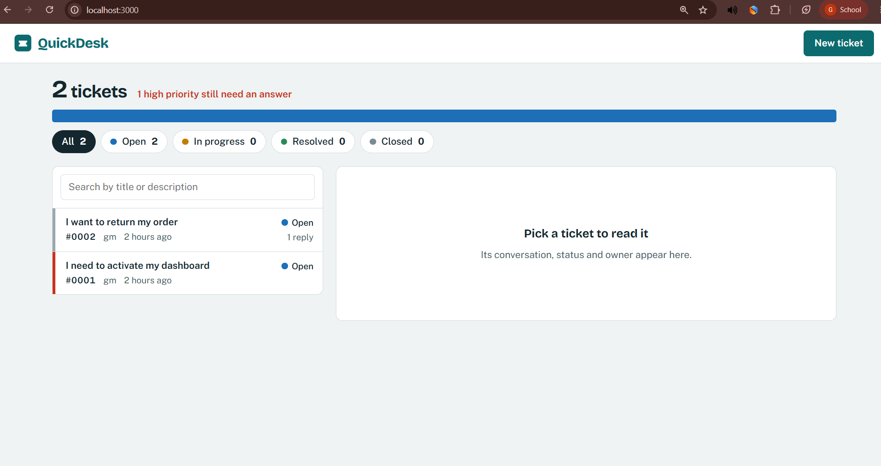



What QuickDesk does
Customers file tickets
Title, details, priority, contact email
Agents triage the queue
Filter by status, search, assign an owner
Talk, then close
Comment thread; closed tickets are frozen until reopened
Notes:
Customers create a ticket with a title, description and priority. Agents see the queue at the top as a single bar, filter by status, open a ticket, assign it, change its status and reply in a comment thread. I added one business rule worth mentioning: a closed ticket is frozen until someone reopens it, and the API enforces that with a 409 conflict. This screenshot is the running app from docker compose.

Slide 3








The journey of one change
Git commit
CI tests
Docker image
Security scan
push to main
pytest + ruff
backend + frontend
Trivy: HIGH / CRITICAL
Registry
Terraform
Helm deploy
Monitoring
GHCR, tag = commit SHA
AWS VPC + EKS
Ingress + autoscaling
Prometheus + Grafana
Every step is a gate: if one fails, nothing after it runs.
Notes:
This is the whole project on one slide. A developer commits and pushes. GitHub Actions runs the tests, builds Docker images, scans them with Trivy and pushes them to the GitHub Container Registry, tagged with the commit SHA. Terraform builds the AWS network and the Kubernetes cluster. Helm deploys the app onto it, and Prometheus and Grafana watch it. Each box is a gate, so a failure stops everything after it. I'll walk through each one.

Slide 4



Application: React, FastAPI, PostgreSQL
Method | Path | Purpose
POST | /api/tickets | Create ticket
GET | /api/tickets | List, filter, search
GET | /api/tickets/stats | Counts by status
GET | /api/tickets/{id} | Ticket + comments
PUT | /api/tickets/{id} | Update ticket
DELETE | /api/tickets/{id} | Delete ticket
GET | /api/tickets/{id}/comments | List comments
POST | /api/tickets/{id}/comments | Add comment
React + Vite
Responsive UI, talks to /api
FastAPI + SQLAlchemy
Validation, business rules, /metrics
PostgreSQL + Alembic
Tables created by versioned migrations
Plus /health, /ready and /metrics for Kubernetes and Prometheus.
Notes:
Three tiers. A React frontend, a FastAPI backend, and PostgreSQL. The database tables are not created by hand: Alembic migrations create them, so every environment gets the same schema. The API has eight ticket and comment endpoints covering GET, POST, PUT and DELETE. There are also three operational endpoints that exist only because of DevOps: health for liveness, ready for readiness, and metrics for Prometheus.

Slide 5
Tests are the first gate
25
8
0
automated pytest tests
endpoints covered, incl. error cases
real databases touched
Tests run against an in-memory SQLite database, so they are fast and can never damage real data
They check rules, not just success: bad input returns 422, a closed ticket returns 409, a missing ticket returns 404
ruff lint runs in the same CI job; a red test fails the pipeline before any image is built
Notes:
The first gate is automated tests. There are twenty five of them. They run against an in-memory SQLite database, so they are fast and cannot touch real data. They test behavior, not only the happy path: invalid input returns 422, a missing ticket returns 404, and editing a closed ticket returns 409. In the pipeline, if any test fails, no image is ever built.

Slide 6
Docker: small, non-root, one command
Backend image
Frontend image (multi-stage)
python:3.12-slim, dependencies cached in their own layer
Runs as uid 10001, never root
Built-in HEALTHCHECK on /health
Stage 1: Node builds the React app
Stage 2: only the static files go into nginx
Runs as uid 101, no Node in the final image
docker compose up --build
starts all three services: frontend on :3000, backend on :8000, PostgreSQL with a health check
Notes:
Both services are containerised. The backend image installs dependencies in a separate layer so rebuilds are fast, and runs as a non-root user. The frontend is a multi-stage build: Node compiles the React app, then only the static files are copied into a small nginx image, so no Node tooling ships to production. Both images run as non-root, which Kubernetes can enforce. And one command, docker compose up with build, starts the whole stack locally.

Slide 7
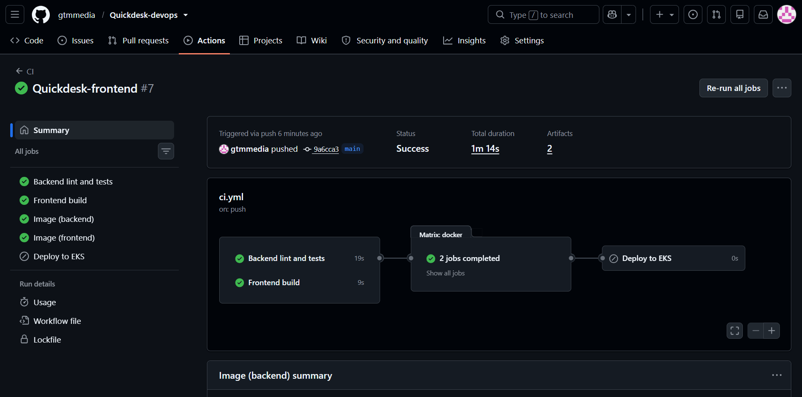
CI/CD with GitHub Actions
backend-test
Screenshot: green GitHub Actions run, and the GHCR package page showing SHA tags
1
ruff + pytest
2
frontend-build
npm ci + build
3
docker (x2)
build, scan, then push
4
deploy
helm upgrade (optional)
Image tag = the Git commit SHA, never "latest"
Notes:
The pipeline is one workflow that runs on every push to main. Jobs one and two run the tests and build the frontend. Only if both pass does the docker job run, once for the backend and once for the frontend: it builds the image, scans it, and only then pushes it to GitHub Container Registry. The tag is the full commit SHA, never latest, so every running pod maps to exactly one commit and rollback is unambiguous. The deploy job is optional and runs helm upgrade on the cluster.

Slide 8
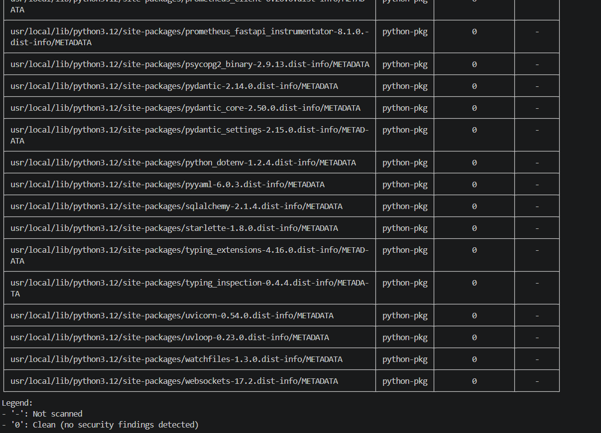
Security: scan before you ship
What Trivy checks
A supply-chain lesson
In March 2026 the version tags of the trivy-action were hijacked. I pinned it to a full commit SHA, which cannot be moved.
OS packages and Python/Node libraries inside each image
Compared against a database of known CVEs
Pipeline fails on HIGH or CRITICAL findings that have a fix
Scan runs before push, so a bad image never reaches the registry
Screenshot: Trivy scan step output from the pipeline
Notes:
Security is a gate, not an afterthought. Trivy scans the operating system packages and the Python and Node libraries inside each image against known vulnerabilities. The pipeline fails on high or critical issues that already have a fix, and the scan happens before the push. While researching I found that the Trivy GitHub Action itself had its version tags hijacked in March 2026, so I pinned it to a commit SHA that cannot be moved. Tools you use to check security are part of your attack surface too. [Explain what your own scan result showed.]

Slide 9
Terraform: AWS infrastructure as code
VPC 10.0.0.0/16
VPC with two public subnets
EKS control plane plus a managed node group of 3 nodes
Add-ons: EBS CSI (database disk), metrics-server (autoscaling)
terraform plan, apply, destroy: no console clicking
Public subnet, zone 1
Public subnet, zone 2
EKS worker node
EKS worker node
EKS worker node
Costs money while running, so I always run teardown and destroy afterwards.
Notes:
The infrastructure is code, not console clicks. Terraform creates a VPC with two public subnets in two availability zones, and an EKS cluster with a managed group of three worker nodes. Two EKS add-ons matter for this app: the EBS CSI driver so PostgreSQL can get a disk, and metrics-server so autoscaling can read CPU usage. I used public subnets without a NAT gateway to keep the demo cost down, which is a trade-off I'd change in production. [Show your terraform plan and AWS console screenshots here.] And I always tear it down afterwards.

Slide 10
Kubernetes + Helm: one chart, whole app
/ to frontend
nginx + React, 2 pods
Internet
Ingress
load balancer
routes by path
/api to backend
PostgreSQL
FastAPI, 2 to 6 pods
StatefulSet + EBS disk
Migrations run in an init container before the backend starts
Liveness (/health) restarts a stuck pod; readiness (/ready) only stops traffic
Deploying a new version = helm upgrade with the new commit SHA
Notes:
Helm packages all the Kubernetes objects into one chart. Traffic comes in through a load balancer to the Ingress, which routes slash-api to the backend service and everything else to the frontend. The database is a StatefulSet with a persistent disk. Two details I'm proud of: migrations run in an init container so replicas never race each other, and the backend has separate liveness and readiness probes, so a database outage stops traffic without restarting pods pointlessly. Deploying a new version is just helm upgrade with the new commit SHA. [Show kubectl get pods, helm list and the browser via the load balancer.]

Slide 11
Autoscaling: HPA watches CPU
desired pods = ceil( current pods x current CPU % / target CPU % )
Worked example
What has to be true
2 pods are using 150% of their CPU request. The target is 60%.
ceil( 2 x 150 / 60 ) = ceil(5.0) = 5 pods
Pods declare a CPU request: the percentage is a percentage of it
metrics-server is installed (Terraform add-on)
Load test: scripts/loadtest.sh, then watch pods go from 2 up to 6
Notes:
The Horizontal Pod Autoscaler adds pods when CPU use is high. The formula is desired pods equals current pods times current utilization divided by target utilization, rounded up. For example, two pods at 150 percent of their request with a 60 percent target gives five pods. That also shows why the pods must declare a CPU request: the percentage is a percentage of the request, so with no request HPA shows unknown. I run a load test script that calls a CPU-heavy debug endpoint and we watch the replicas climb from two toward six. [Show kubectl get hpa -w during the load test.]

Slide 12
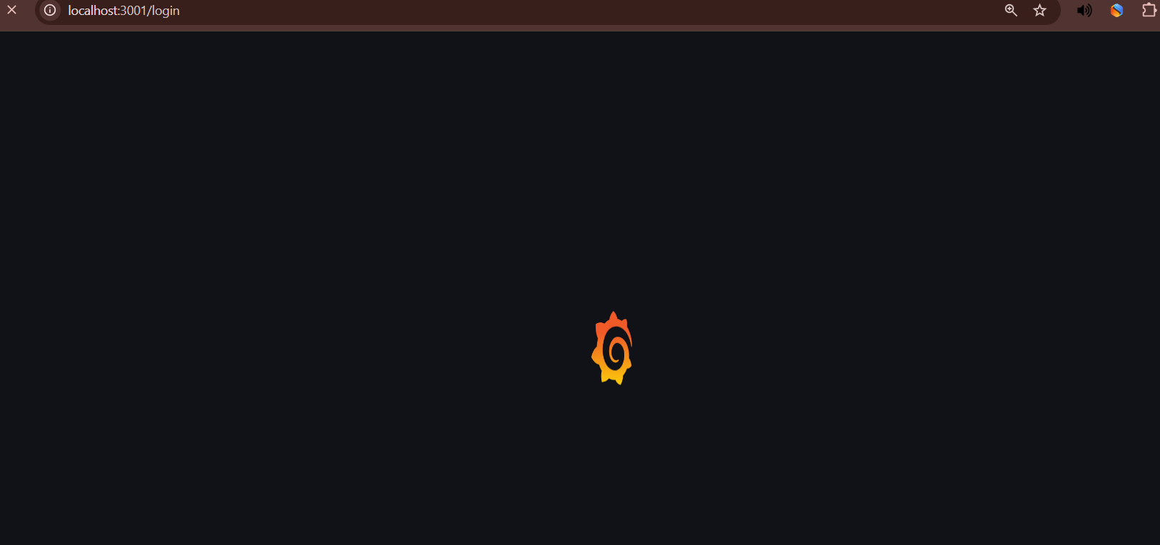
Monitoring: Prometheus + Grafana
Backend
Screenshot: Grafana "QuickDesk overview" dashboard with live panels
/metrics
Prometheus
scrapes every 15s
Grafana
dashboard
HTTP requests and latency per endpoint
Business metric: tickets by status, from the database
Pod count and CPU vs request, to see autoscaling
Notes:
The backend exposes a metrics endpoint. A ServiceMonitor in the Helm chart tells Prometheus to scrape it every fifteen seconds, and Grafana loads a dashboard I provisioned as code. It shows request rate and latency per endpoint, a business metric, tickets by status counted from the database, and the pod count against CPU so you can see autoscaling happen. [Show the Prometheus targets page with the backend UP, then the dashboard.]

Slide 13


Troubleshooting: read the Events
ImagePullBackOff
Running, but 0/1 Ready
Init: CrashLoopBackOff
Cause: Wrong or missing image tag
Cause: Readiness probe failing
Cause: Backend cannot reach the database
Check: kubectl describe pod
Check: kubectl describe pod
Check: kubectl logs -c migrate
Fix: Use a tag that exists, or rollout undo
Fix: Fix the probe path or the dependency
Fix: Correct the DATABASE_URL secret
Method: get (what state?), describe (read Events), logs (what did the app say?), then fix and verify.
Notes:
Now the part I practised the most: breaking things on purpose. I have scripts and eight broken manifests for this. Three examples. A wrong image tag gives ImagePullBackOff, and describe pod shows the exact reason in Events. A failing readiness probe leaves the pod running but not ready, so it never receives traffic. A wrong database password makes the migration init container fail, which I see with logs for that container. The method is always the same: get, describe, logs, then fix and verify. [Do a live break and fix with scripts/break.sh here.]

Slide 14

What I learned
Gates catch problems early. Observability makes behaviour visible. Linear migration history matters.
Thank you. Questions?
Notes:
Three things I learned. First, gates work: every problem I hit, a bad test, a scan, a probe, was caught at the earliest stage that could catch it. Second, you can't run what you can't see, so observability made autoscaling and failures visible. Third, small details bite: my database migrations once had two starting points, which stopped the backend from starting until I fixed the revision chain. [Replace with your own lessons.] Thank you, I'm happy to take questions.

